Slide 1
J58 (JT11D-20)
Aponte, Edwin; Lagares, Christian; Quijano, Joel
Department of Mechanical Engineering
INME 4707-030
University of Puerto Rico at Mayaguez

Slide 2
J58 (JT11D-20) – Project Summary
As a requisite for Turbine and propulsion system class, for a better understanding and knowledge of a jet engine, we analyze and validate data for a J58 engine. Furthermore, important jet engine performance parameters such as thrust, TSFC, maximum operation temperature, range and others will presented to validate the code generated usign MatLab and discuss the optimal operation condition of the jet engine.
Notes:
Quijano

Slide 3
J58 (JT11D-20) – Introduction
To gain a better understanding of turbojet engines it is important to analyze the engine characteristics over a range of condition to fully grasp the capabilities of the engine. To that end, an analytical model will be developed that describes the impact of changes in component characterization on the overall performance of a turbojet engine. This will be done for a range of conditions to survey the design space.
Notes:
Aponte

Slide 4
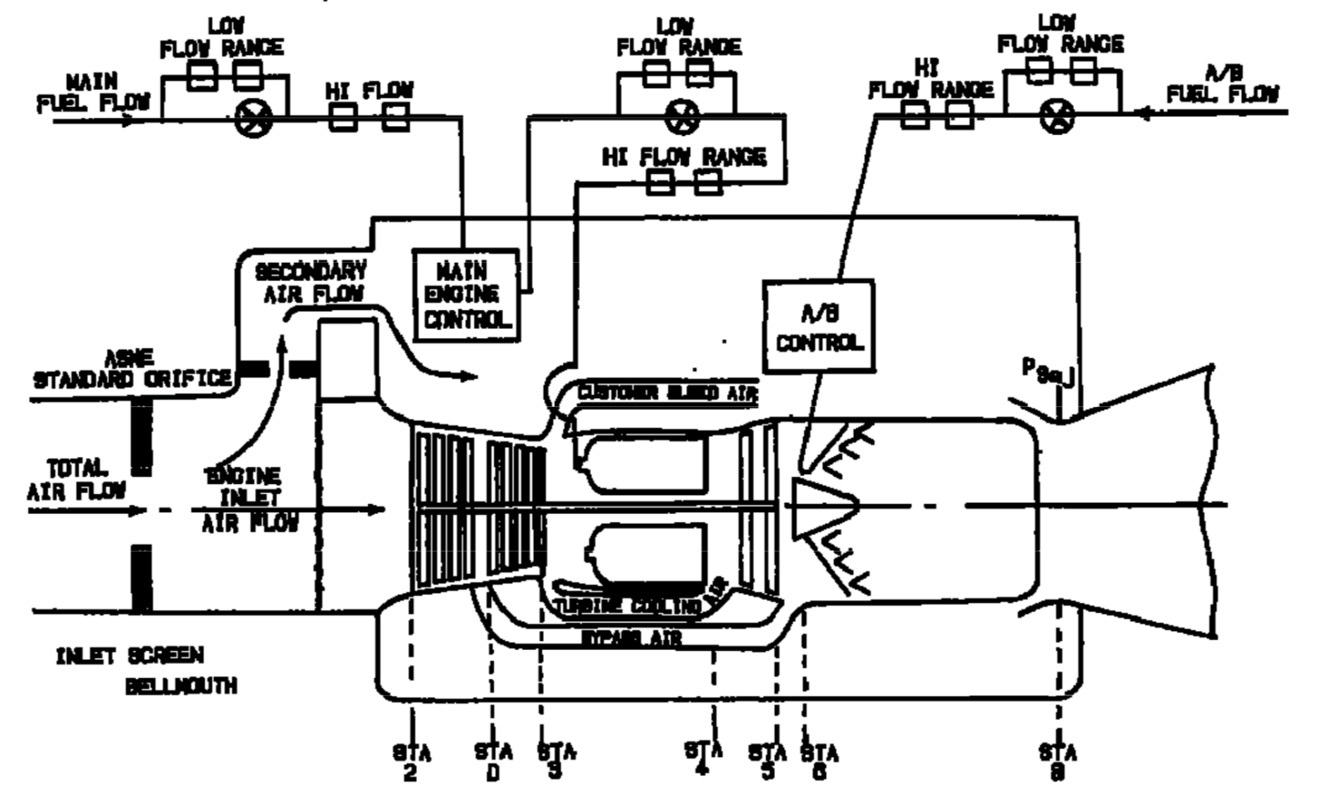
J58 (JT11D-20) – Introduction
Figure 1: Standard J11D-20 Station Nomenclature [1]
Notes:
Lagares

Slide 5
J58 (JT11D-20) – Introduction
Table 1: Maximum Operating Temperatures [1] [2]
COMPONENT/STAGE | TEMP (ºF) | TEMP (ºC)
Inlet T1 | 800+ | 426+
COMPRESSOR Inlet T2 | 800+ | 426+
COMPRESSOR 4th Stage TD | 1050 | 565.56
COMBUSTOR Inlet T3 | 1300 | 704.44
TURBINE Inlet T4 | 2000 | 1093.33
TURBINE Exit T5 | 1450 | 787.78
AB T6 | 3200 | 1760
Exhaust NOZZLE T8 | 1500 | 815.15
Notes:
Lagares

Slide 6
J58 (JT11D-20) – Introduction
Table 2: Engine Specs
SPECIFICATION | VALUE RANGE [EN] | VALUE RANGE [SI]
Altitude [4] | 25K-90K ft | 7.62 – 27.43 km
Speed [5] | Mach 0.75 – 3.2
Dry TSFC @ Max Thrust [6] | 0.8 lb/lbf hr | 81.6 kg/kN hr
Wet TSFC @ Max Thrust [6] | 1.9 lb/lbf hr | 164 kg/kN hr
Fuel [7] | JP-7
Fuel Storage [8] | 80,285 lb | 36,416 kg
Fuel Lower Heating Value [9] | 5.48 kWh/lb | 43,682 kJ/kg
Thrust [7] | 32,500 lbf | 144,567 N
Air Volume Flow @ Cruise [10] | 100K ft³/s | 2831.68 m³/s
Notes:
Lagares

Slide 7
J58 (JT11D-20) – Introduction
Table 2: Engine Specs (Cont.)
SPECIFICATION | VALUE RANGE [EN] | VALUE RANGE [SI]
Compression Ratio < Mach 2.2 [8] | 8.8:1
Compressor [11] | 8-Stage Axial
Turbine [11] | 2-Stage
Weight [11] | 6,500 lb | 2,948 kg
Air Mass Flow [8] | 326-450 lb/s | 147 – 204 kg/s
Dry Fuel Mass Flow @ Max | 5.55 lb/s | 2.52 kg/s
Wet Fuel Mass Flow @ Max | 17.94 lb/s | 8.14 kg/s
Dry Fuel to Air Ratio | 0.012-0.017
Wet Fuel to Air Ratio | 0.0398-0.055
Notes:
Lagares

Slide 8
J58 (JT11D-20) – Introduction
Table 3: Validation Flight Conditions
Condition ID | Altitude [ft] | Mach | Afterburner
Takeoff [2] | 0 (@ Sea level) | 0.3542 | ON
Refueling/Buddy Mission [2] | 25000 | 0.75 | OFF
Climbing [2] | 30000 | 1.25 | ON
Concorde [12] | 60000 | 2.00 | ON
YF12A (03/18/65) | 65000 | 2.2 | ON
A12 Max Altitude at Mach 2.2 | 75000 | 2.2 | ON
Lake County Airport | 9928 | 0.3545 | ON
Lowest Altitude at Mach 1.0 | 15000 | 1.0 | ON
MA139-XAA | 40000 | 1.9 | ON
French Griffon II | 61000 | 2.1 | ON
Constant climb | 33000 | 0.9 | ON
Supersonic transport flight | 70000 | 2.5 | ON
Notes:
Lagares

Slide 9
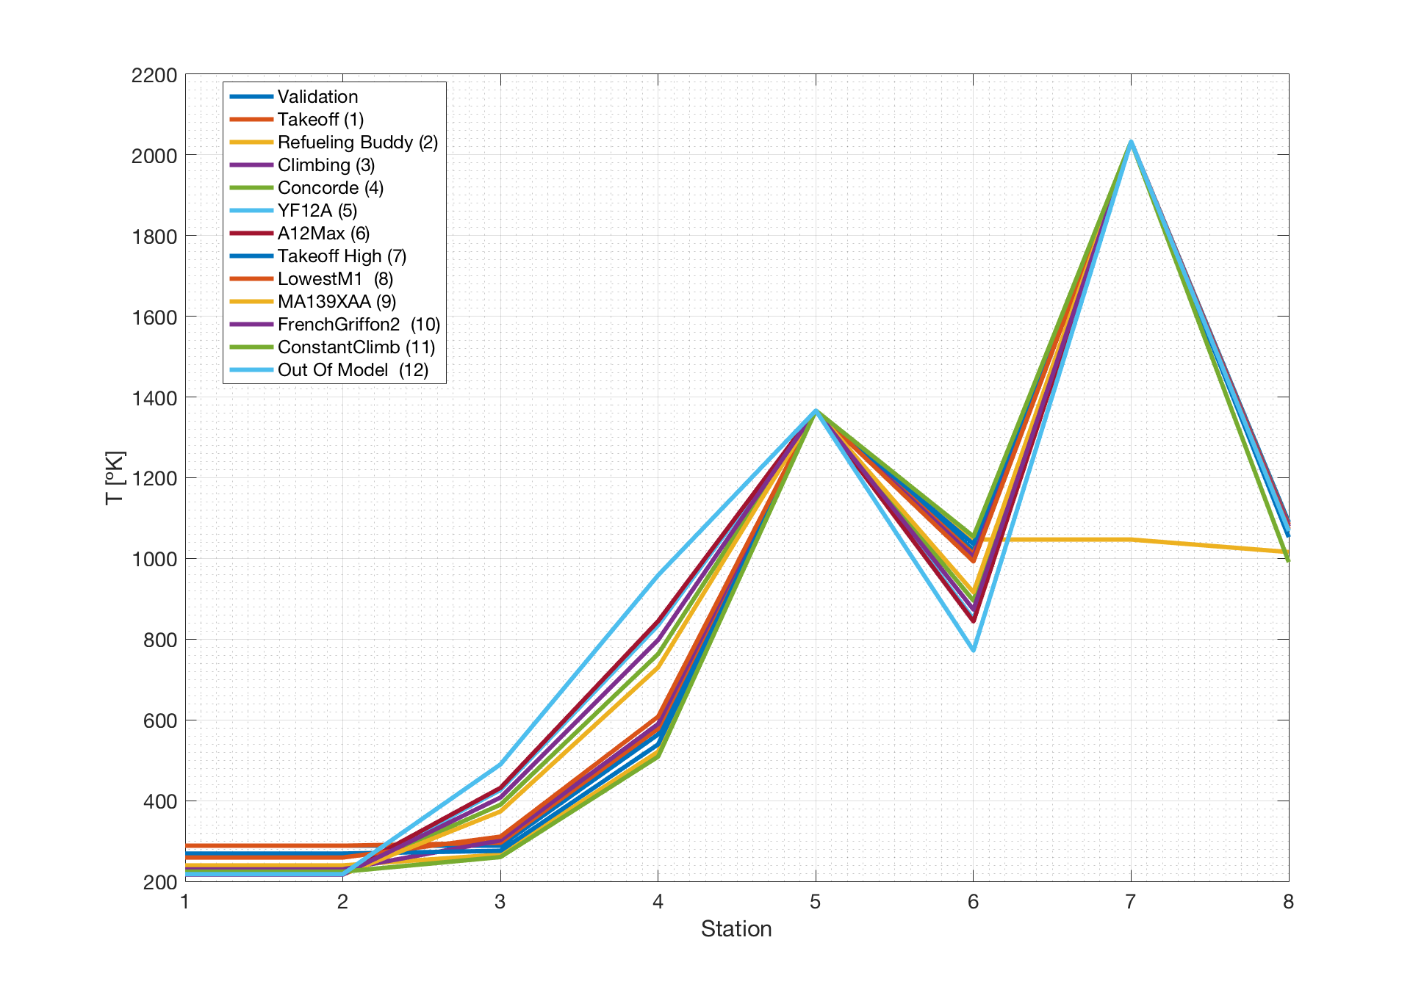
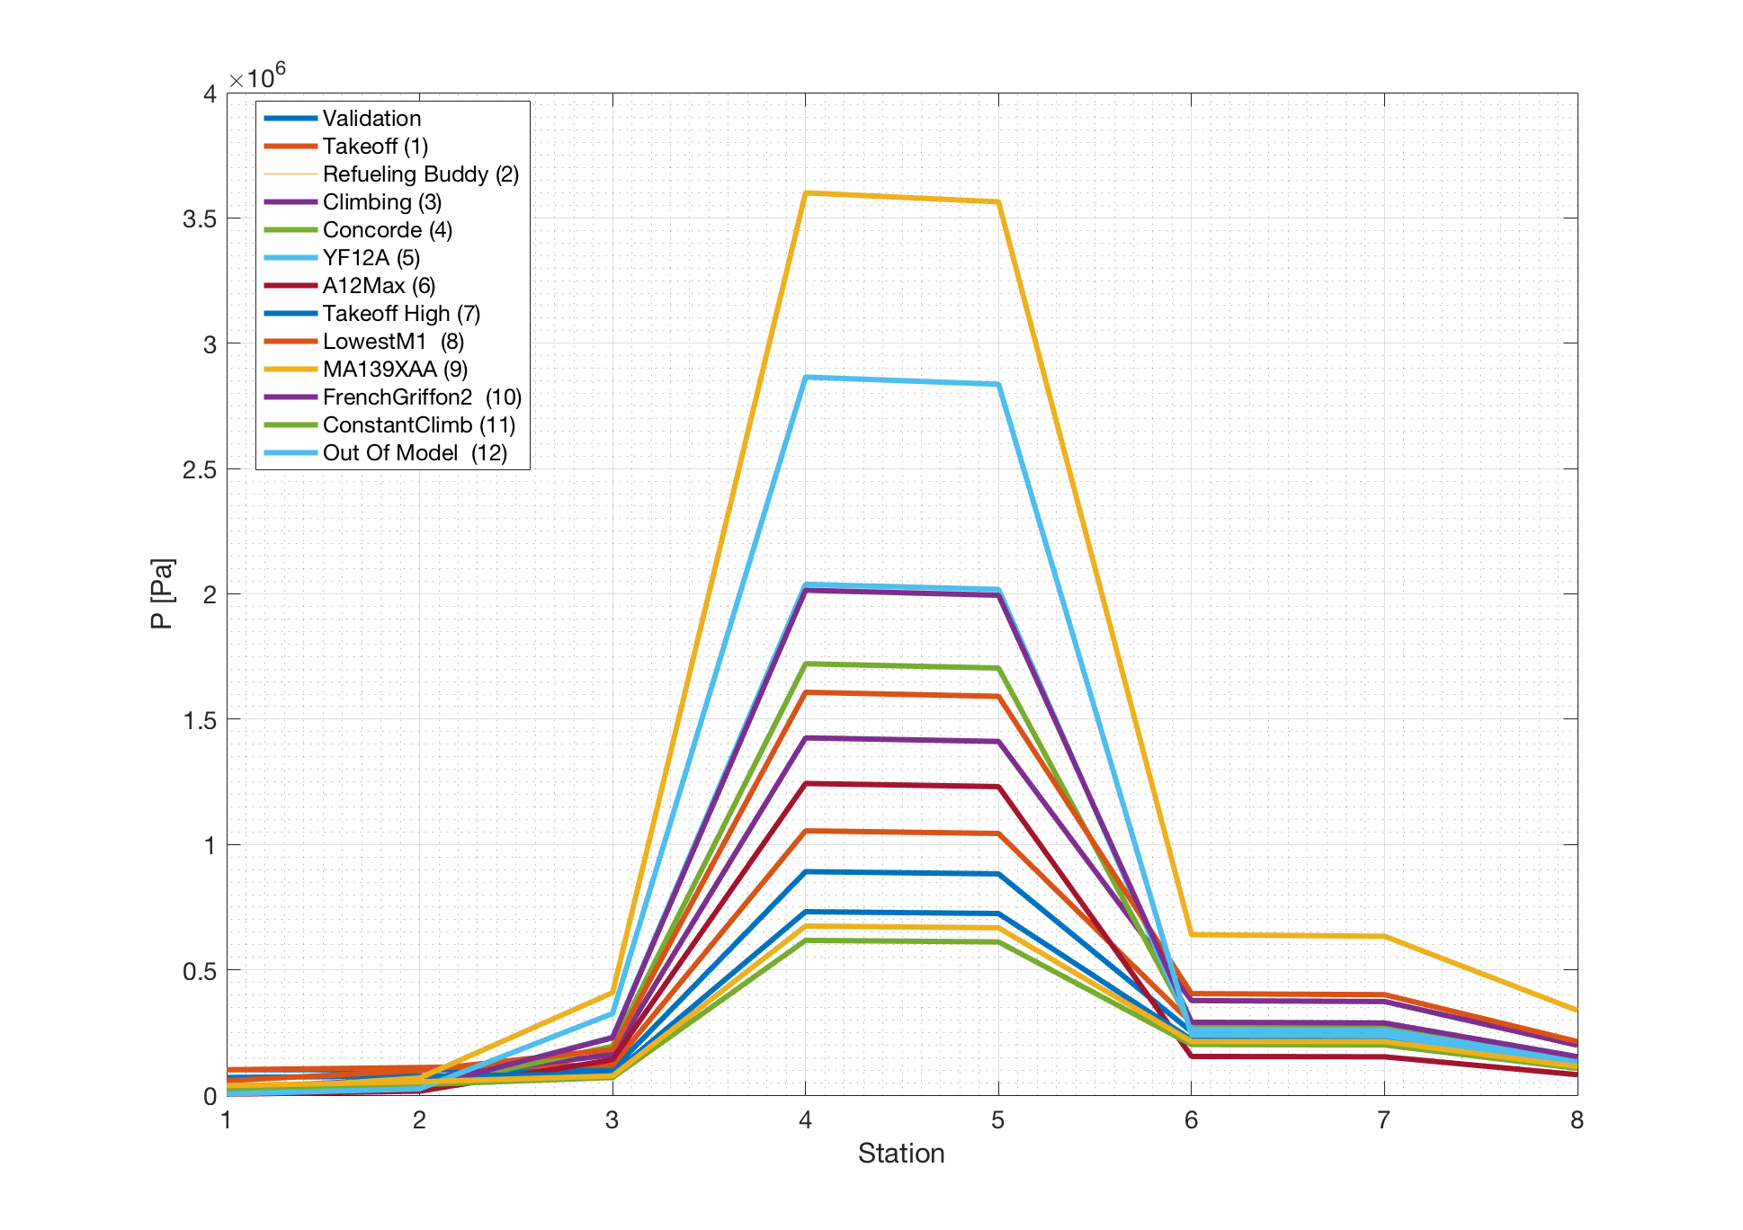
Temperature and Pressure Distributions
Figure 10-11: Pressure/Temp. vs Station

Slide 10
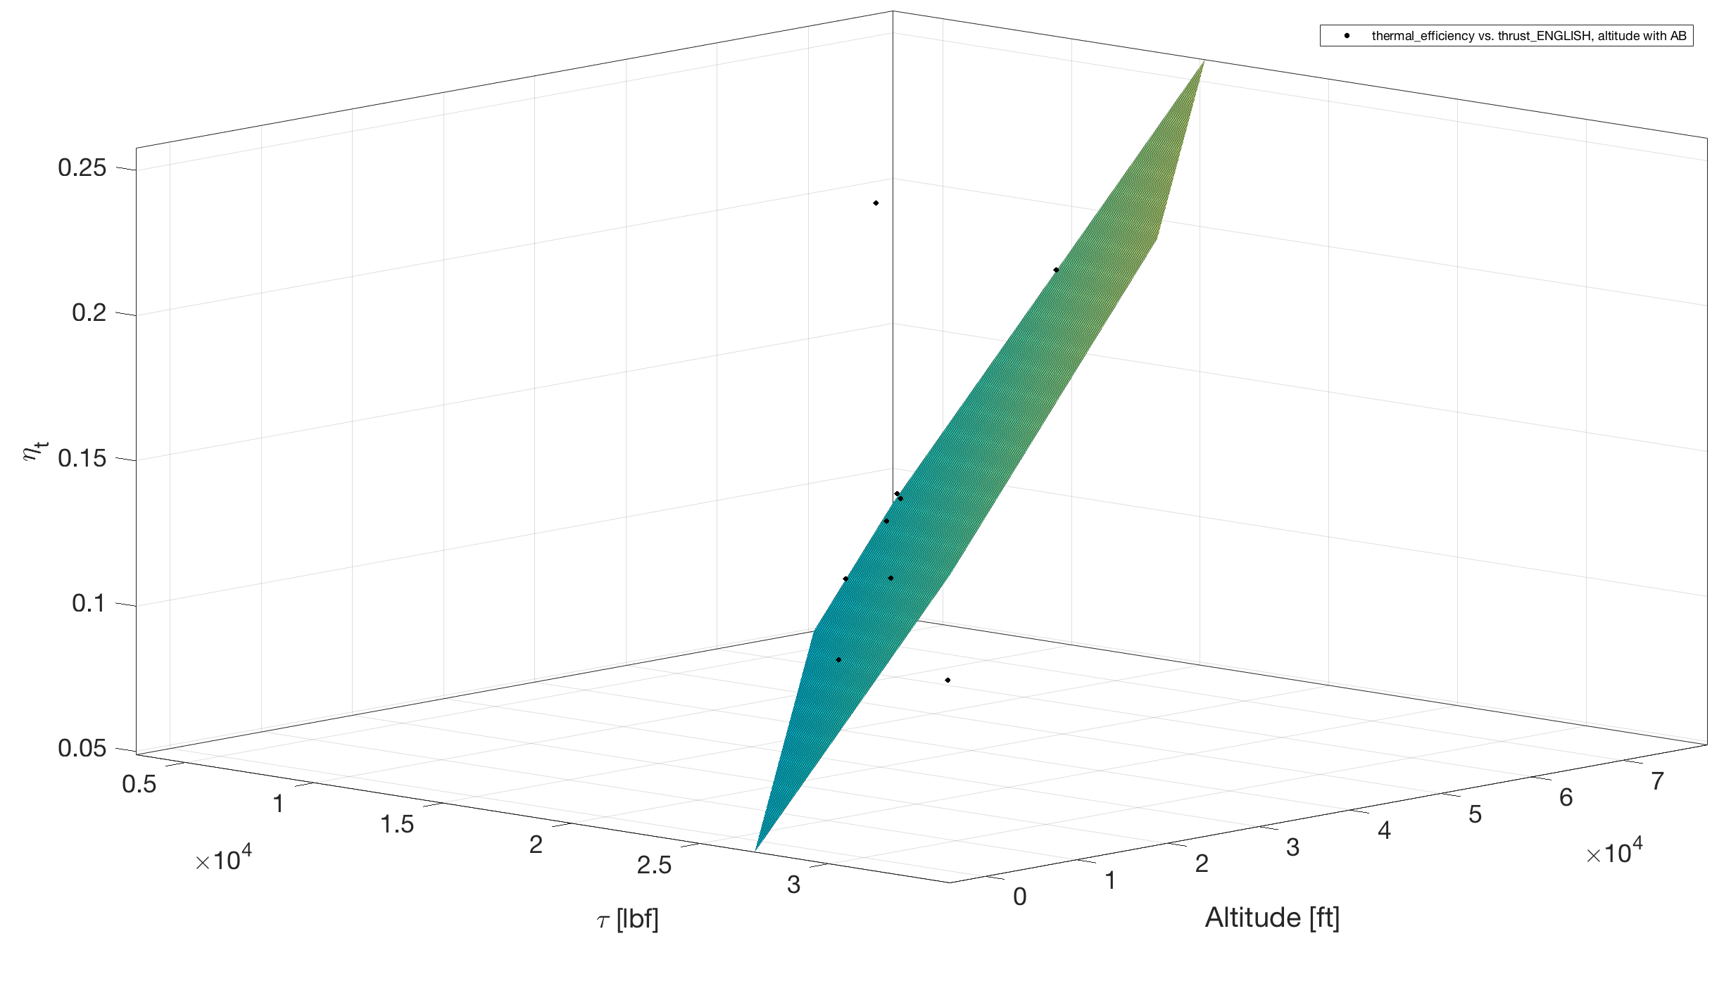
Thermal Efficiency vs Thrust/Altitude
Figure 12: Thermal Efficiency vs Thrust/Altitude

Slide 11
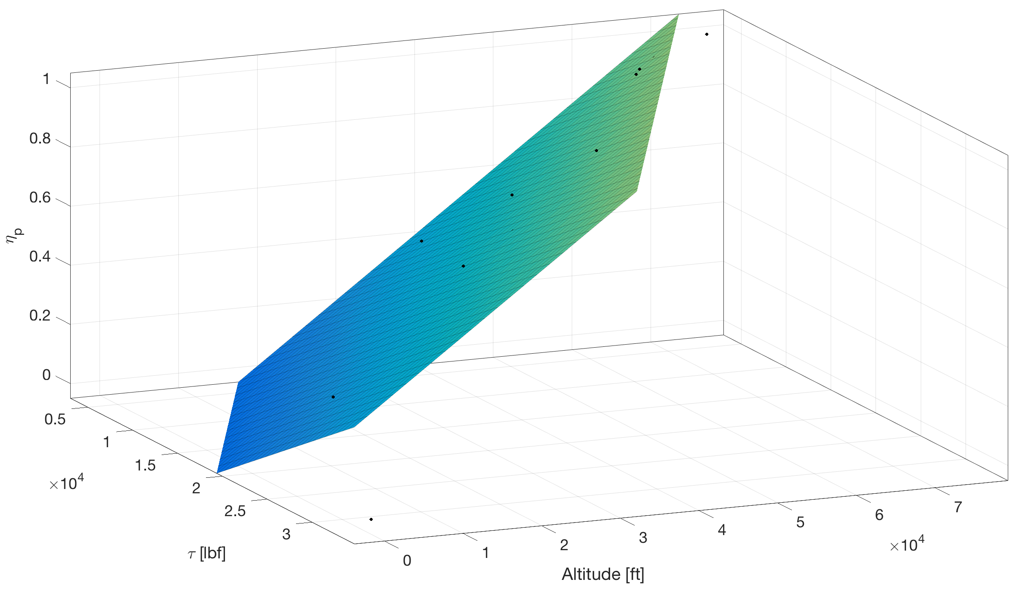
Propulsive Efficiency vs Thrust/Altitude
Figure 13: Propulsive Efficiency vs Thrust/Altitude

Slide 12
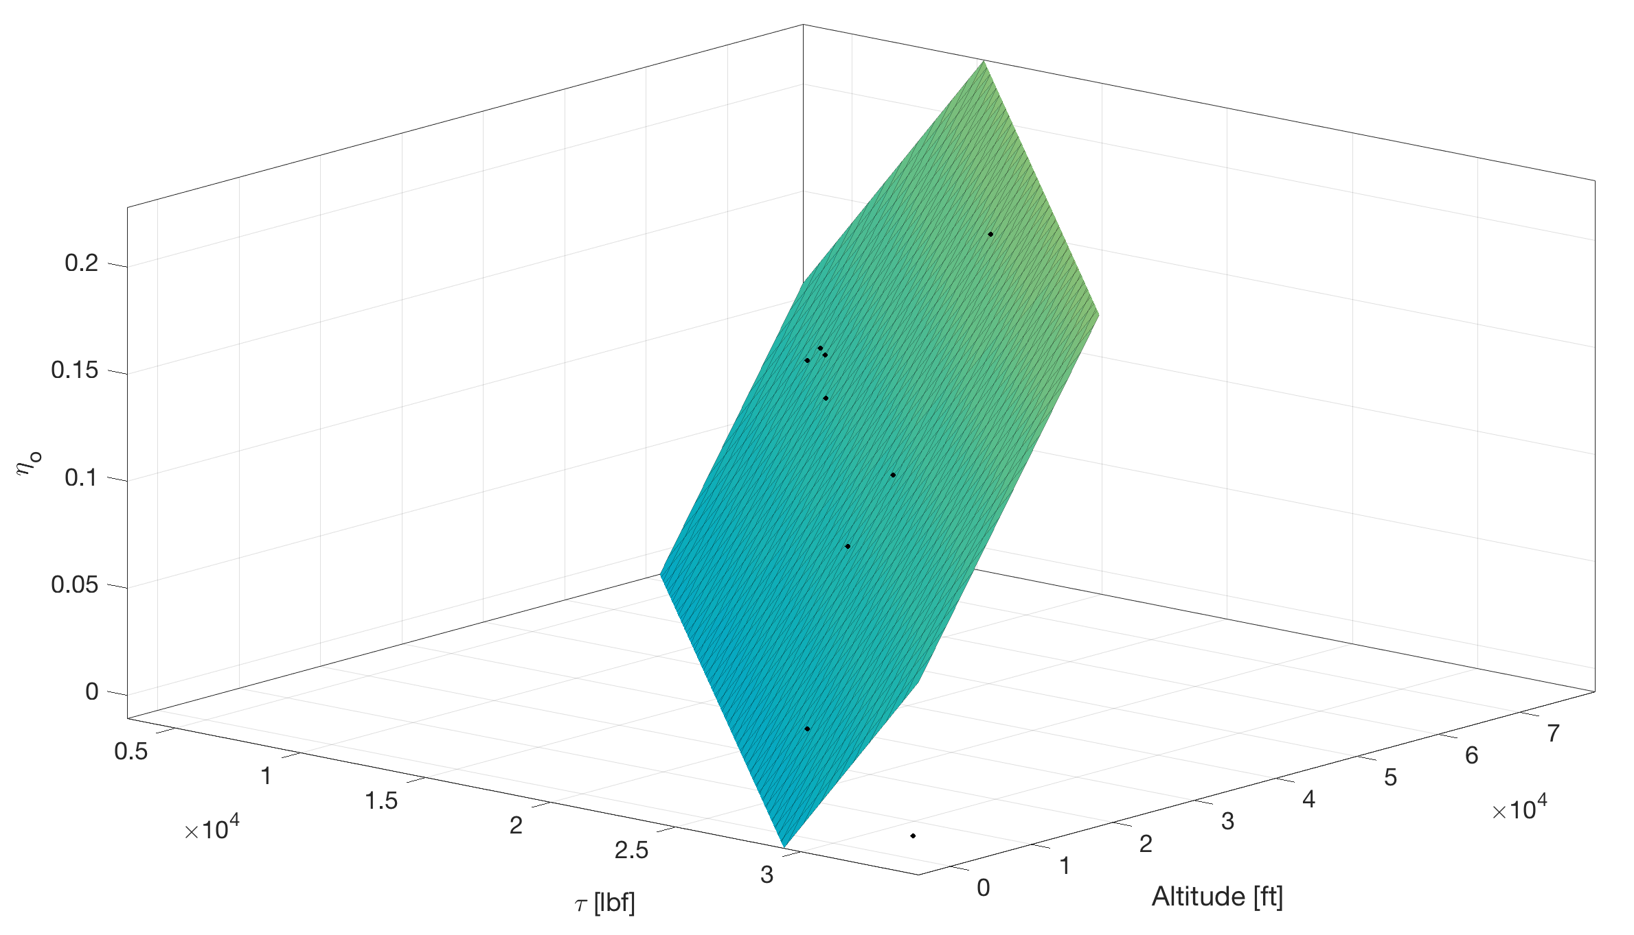
Overall Efficiency vs Thrust/Altitude
Figure 14: Overall Efficiency vs Thrust/Altitude

Slide 13
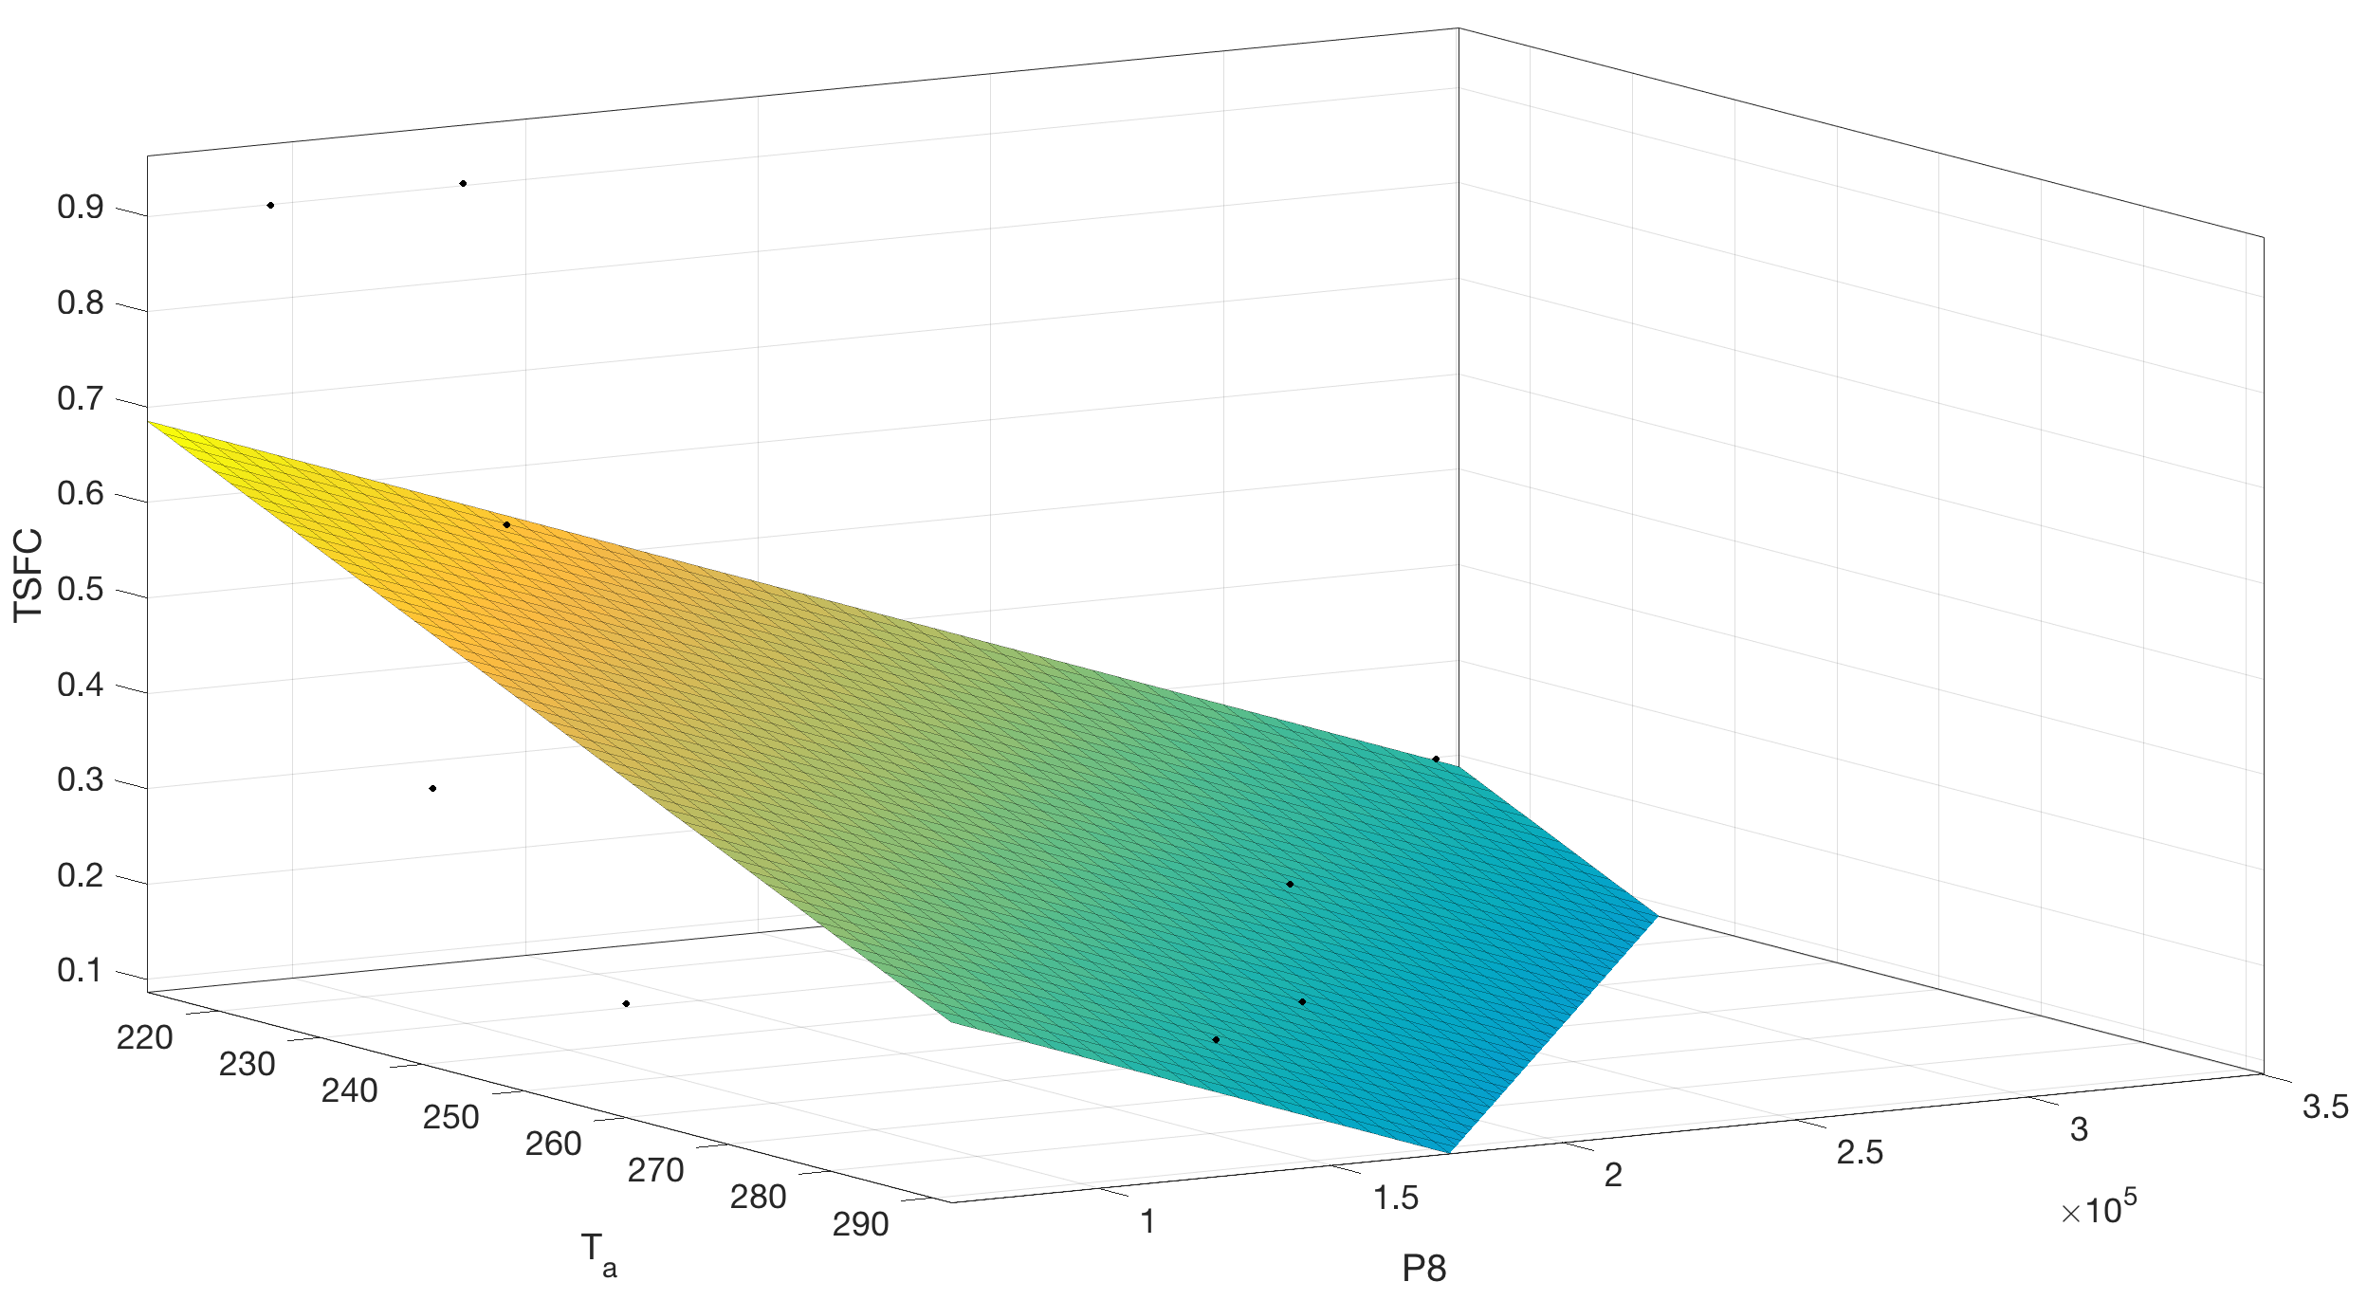
TSFC
Figure 15: TSFC vs Atmospheric Temperature/Exit Pressure

Slide 14
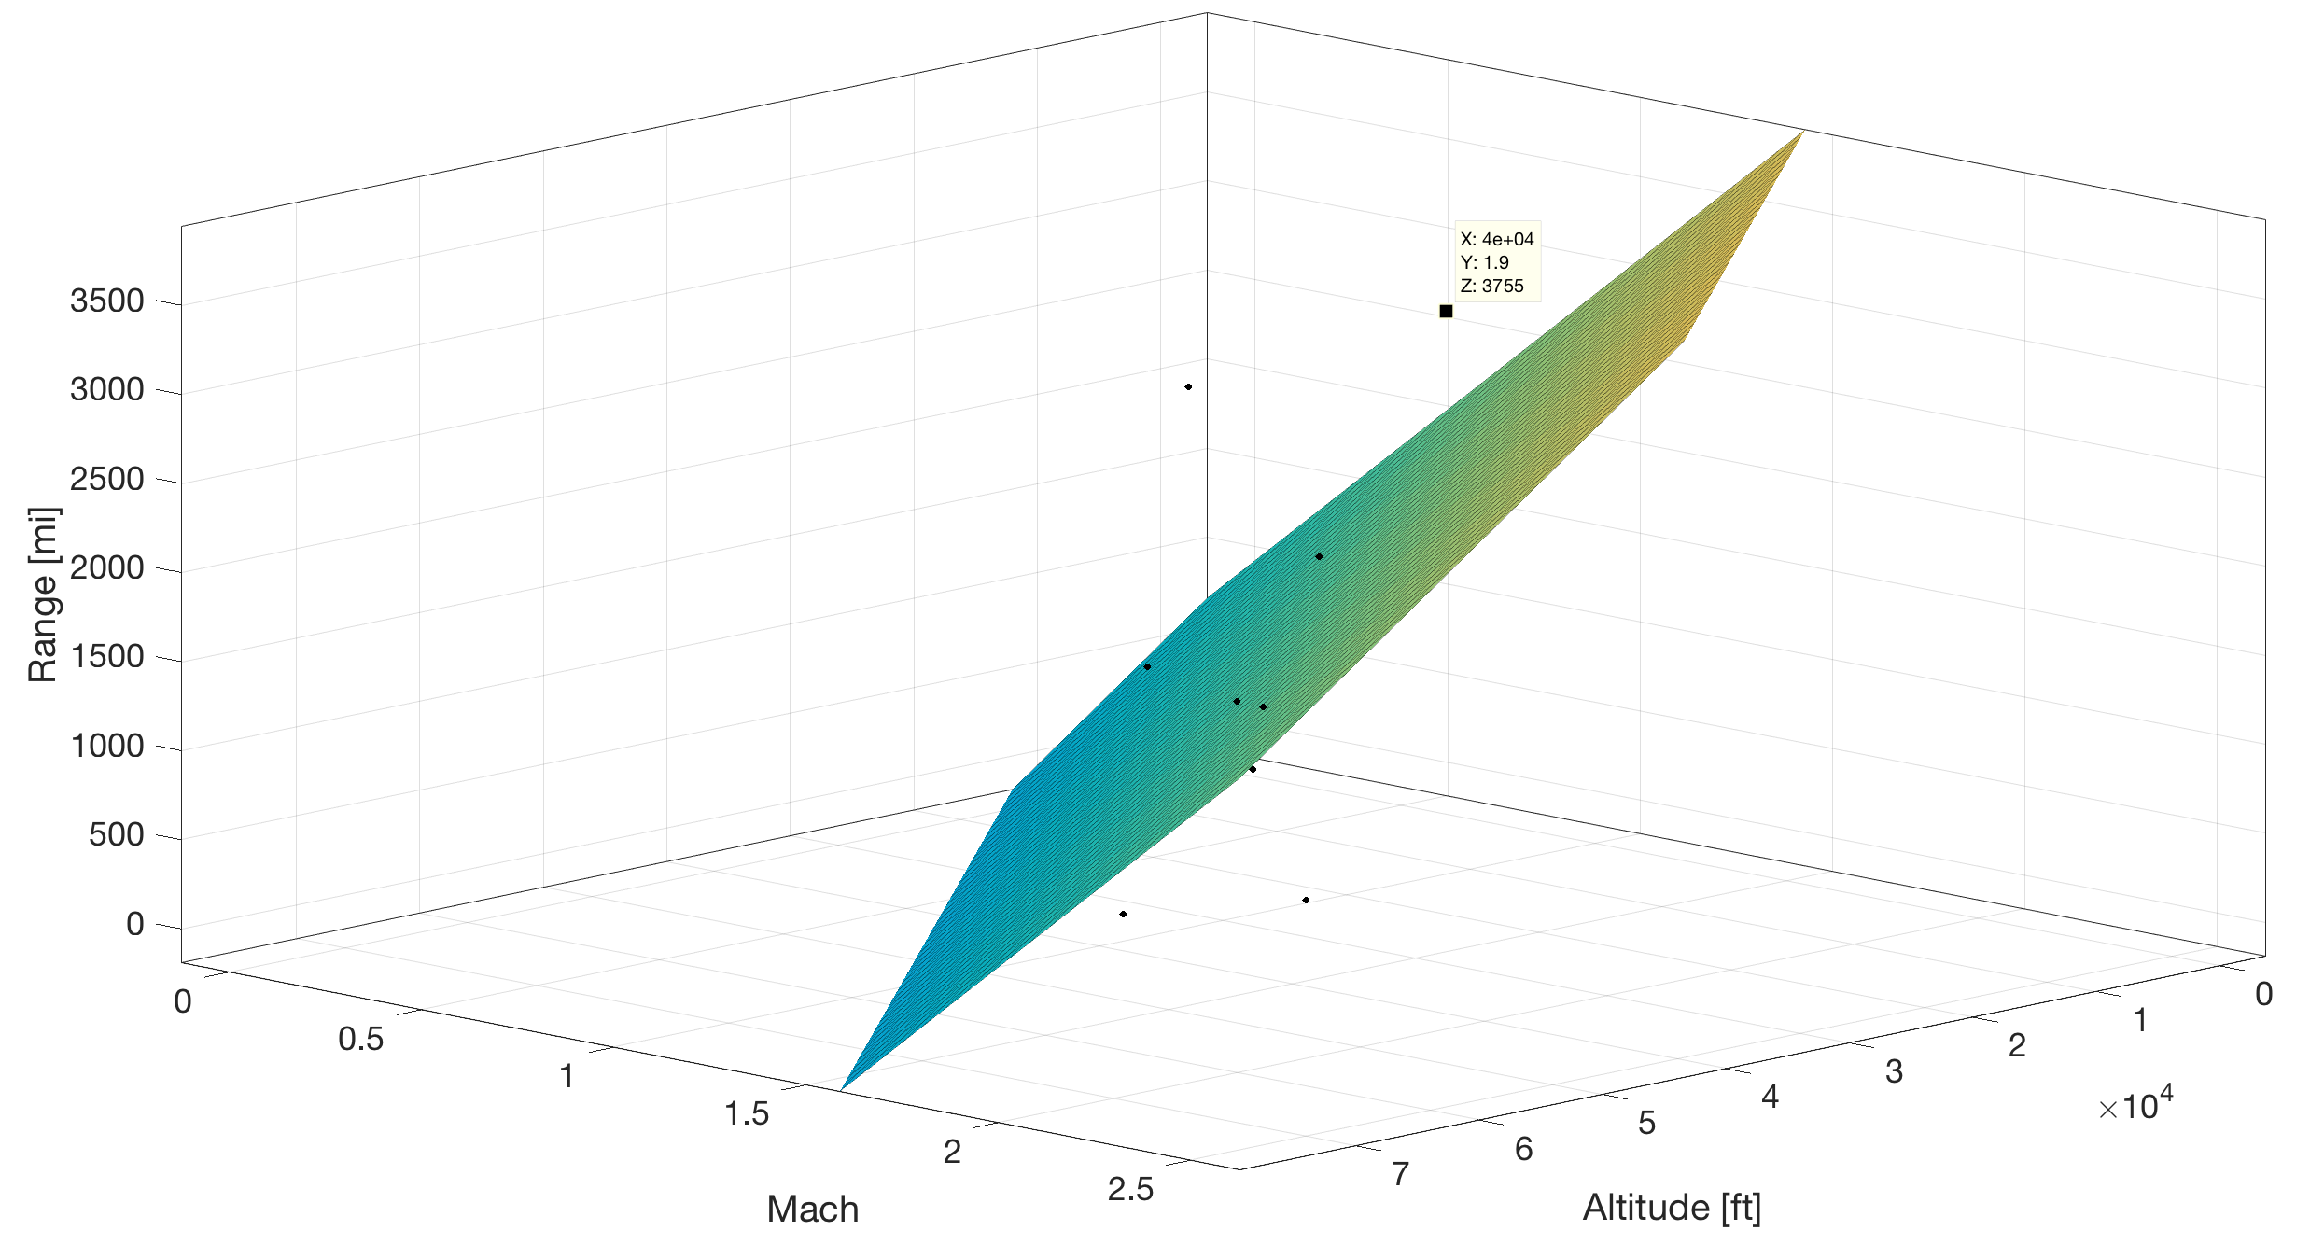
Range
Figure 16: Range vs Mach/Altitude

Slide 15
J58 (JT11D-20) – Conclusion
Table 3: Validation Flight Conditions
Condition ID | Altitude [ft] | Mach | Afterburner | TSFC [kg/N-h] | Overall Efficiency
Max Thrust [2] VAL. (2.23%) | 0 | 0 | ON | 2.11 | 0.00
Takeoff [2] | 0 | 0.3542 | ON | 2.42 | 0.04
Refueling/Buddy Mission [2] | 25000 | 0.75 | OFF | 1.24 | 0.15
Climbing [2] | 30000 | 1.25 | ON | 2.71 | 0.11
Concorde [12] | 60000 | 2.00 | ON | 4.36 | 0.10
YF12A (03/18/65) | 65000 | 2.2 | ON | 5.45 | 0.096
A12 Max Altitude at Mach 2.2 | 75000 | 2.2 | ON | 9.10 | 0.058
Lake County Airport | 9928 | 0.3545 | ON | 2.48 | 0.037
Lowest Altitude at Mach 1.0 | 15000 | 1.0 | ON | 2.54 | 0.10
MA139-XAA | 40000 | 1.9 | ON | 2.09 | 0.21
French Griffon II | 61000 | 2.1 | ON | 4.53 | 0.11
Constant climb | 33000 | 0.9 | ON | 3.06 | 0.071
Supersonic transport flight | 70000 | 2.5 | ON | 9.06 | 0.065
Notes:
Lagares

Slide 16
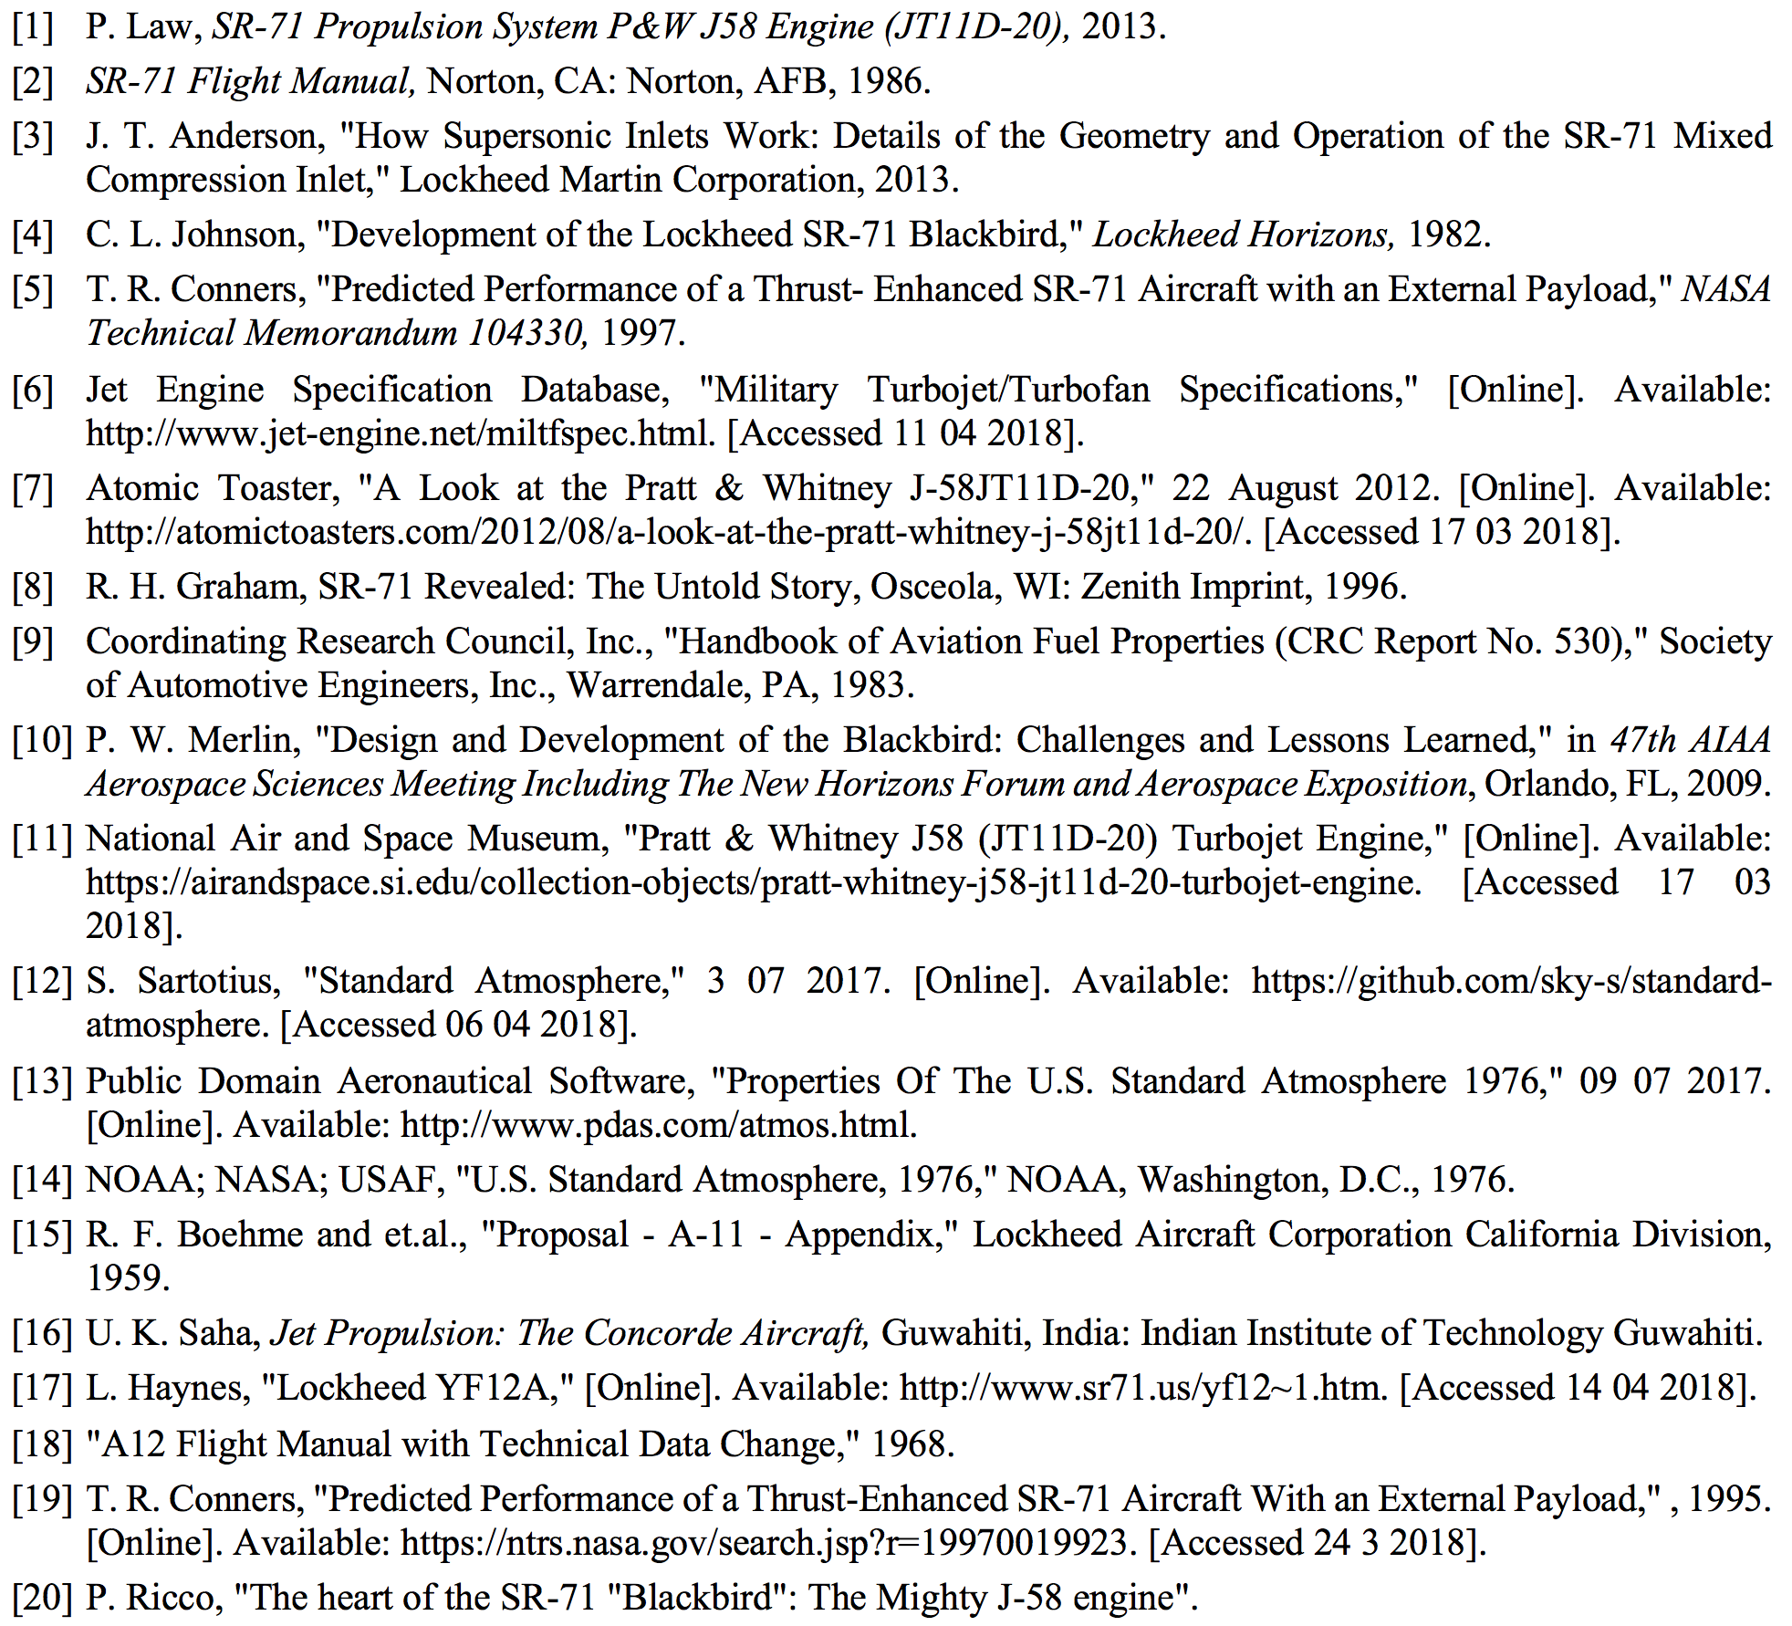
References
Notes:
Lagares/Aponte

Slide 17


Slide 18
BACKUP SLIDES
APPENDIX A

Slide 19
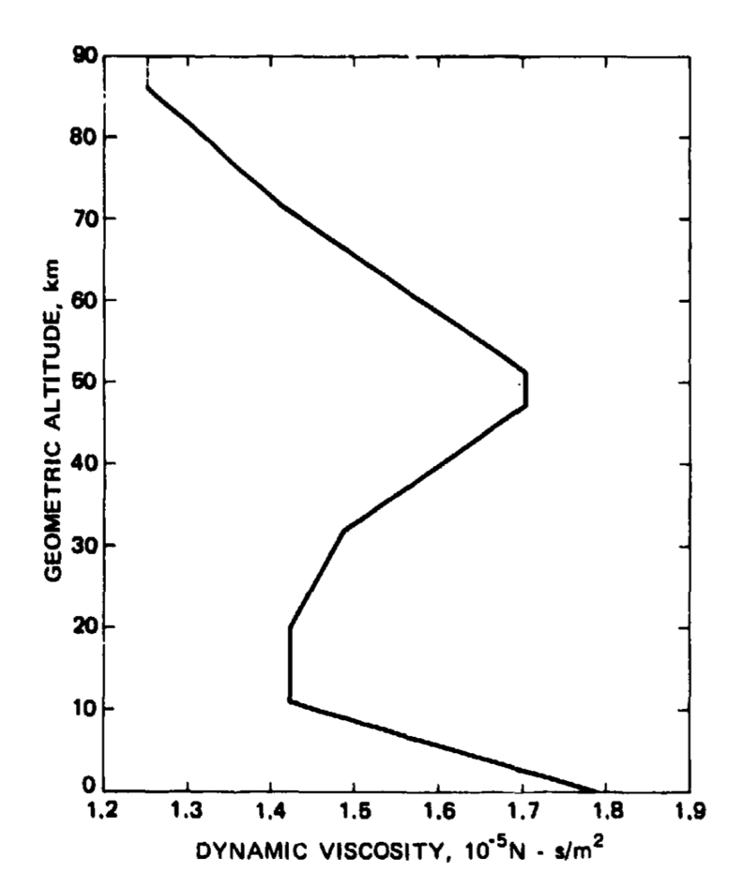
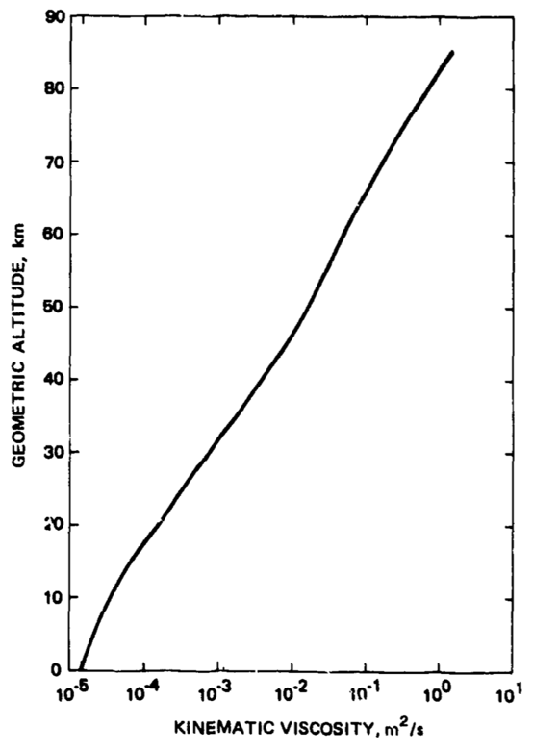
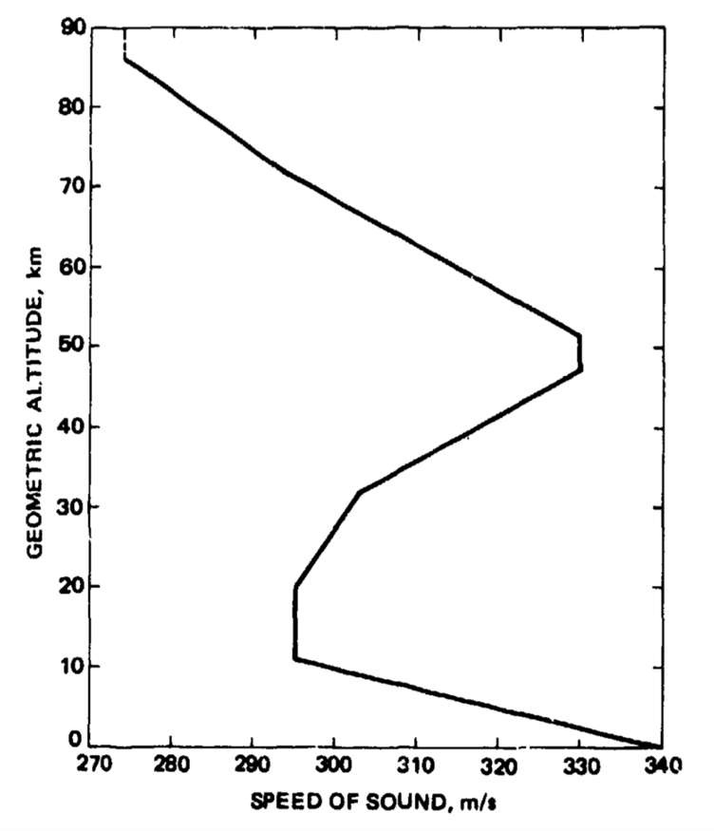
J58 (JT11D-20) – Standard Atmosphere
Figure 2-4: Standard Atmosphere Dynamic Viscosity, Kinematic Viscosity and Speed of Sound [15]
Notes:
Lagares

Slide 20
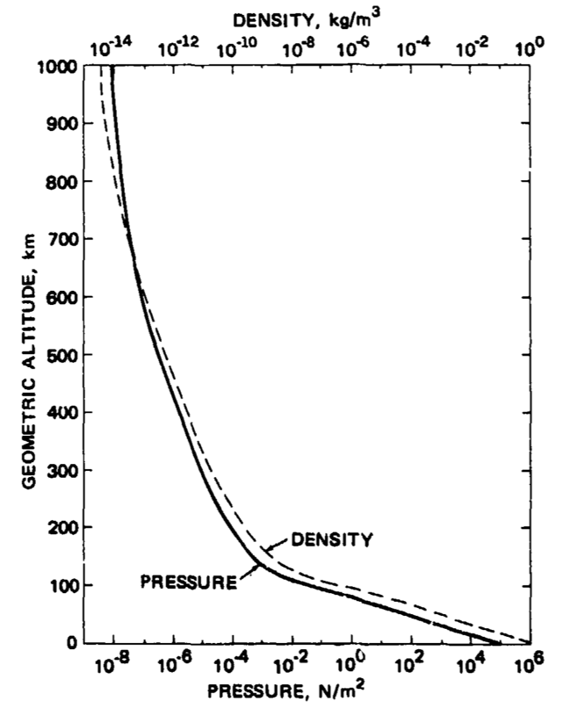
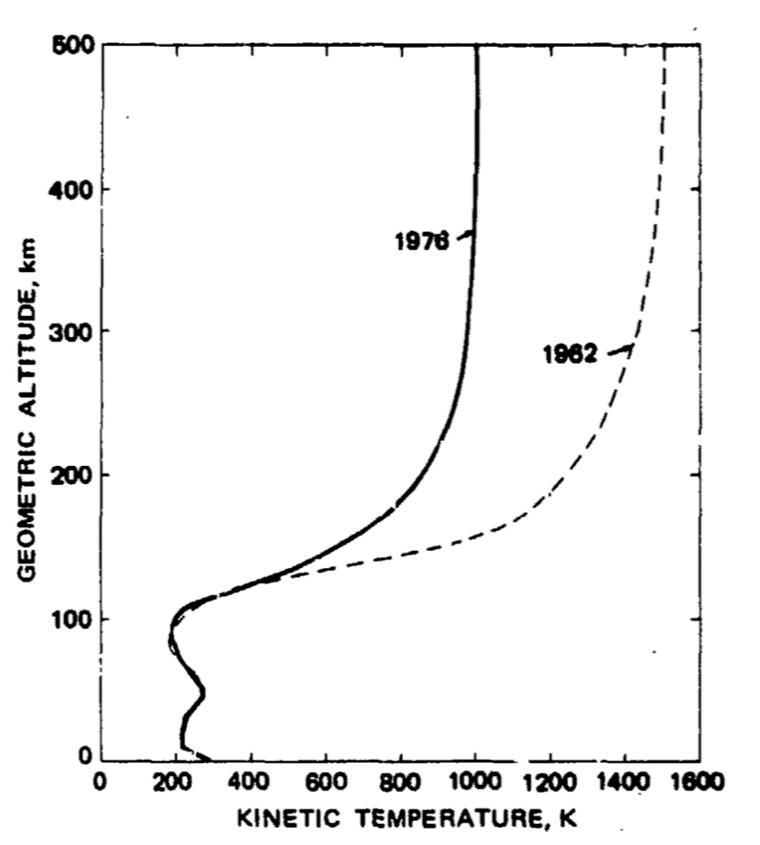
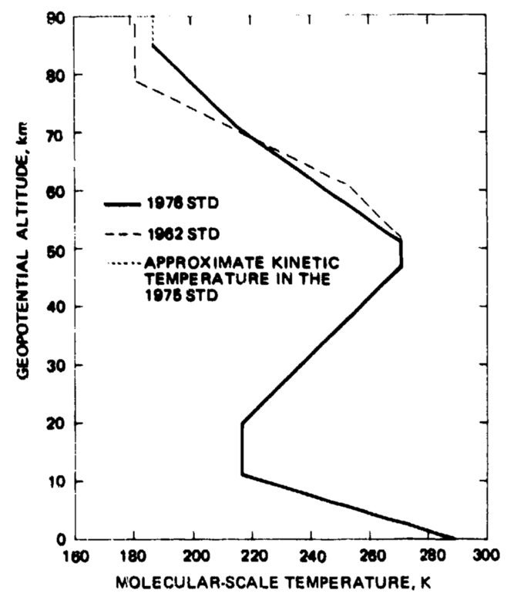
J58 (JT11D-20) – Standard Atmosphere
Figure 5-7: Standard Atmosphere Pressure, Kinetic Temperature and Molecular-Scale Temperature [15]
Notes:
Lagares

Slide 21
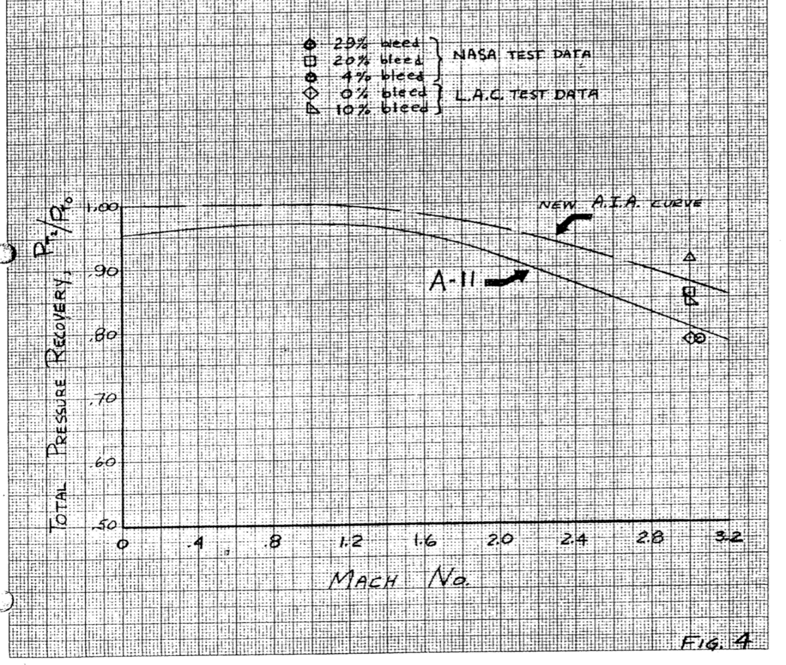
J58 (JT11D-20) – Inlet
Figure 8: Expected Inlet Performance [16]
Notes:
Lagares

Slide 22
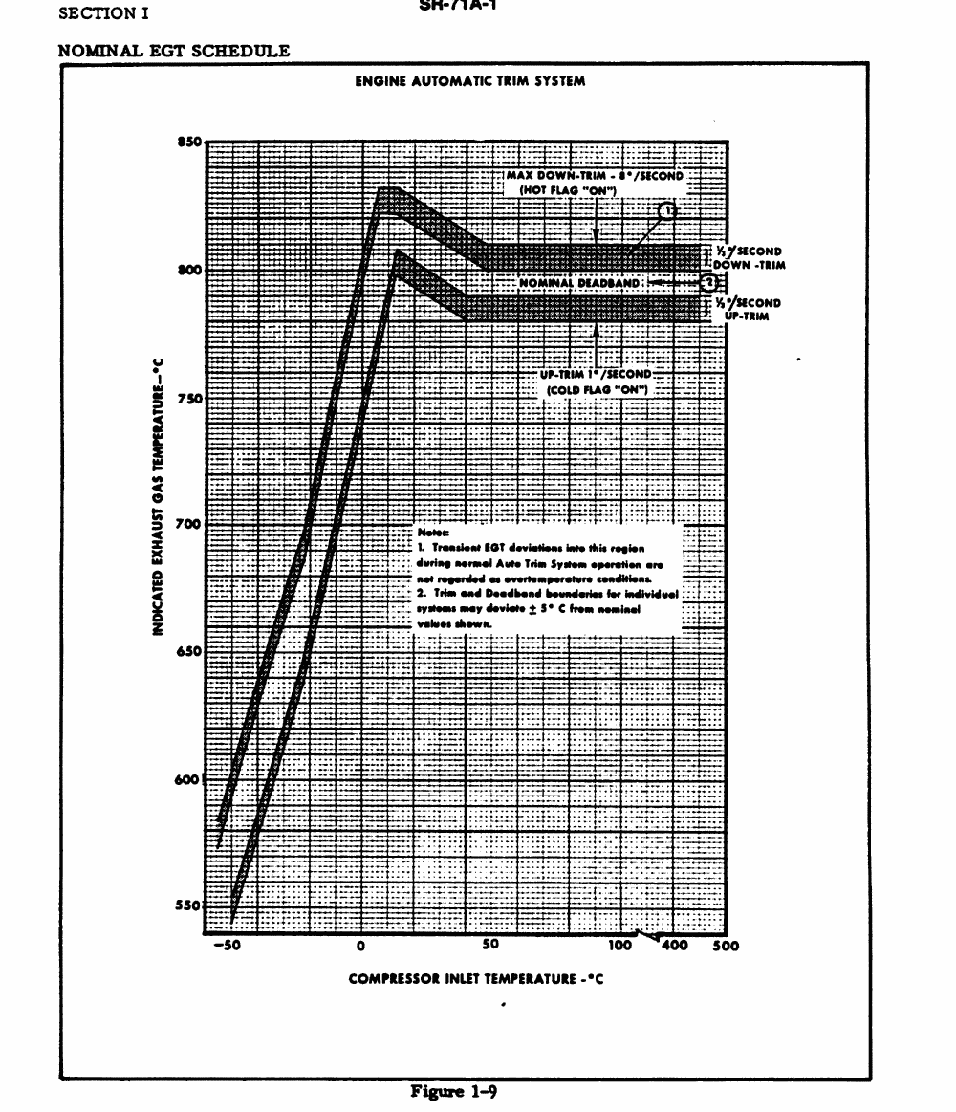
J58 (JT11D-20) – EGT
Figure 9: Indicated EGT vs Compressor Inlet Temperature [2]
Notes:
Lagares

Slide 23
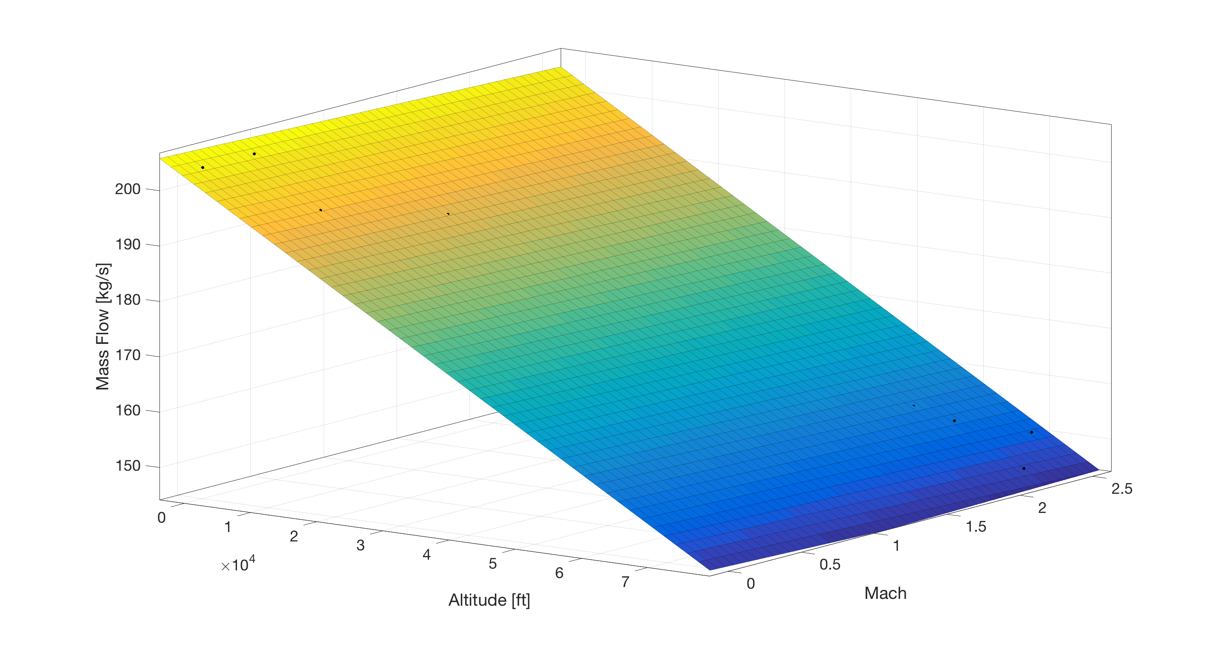
Mass Flow Variation

Slide 24
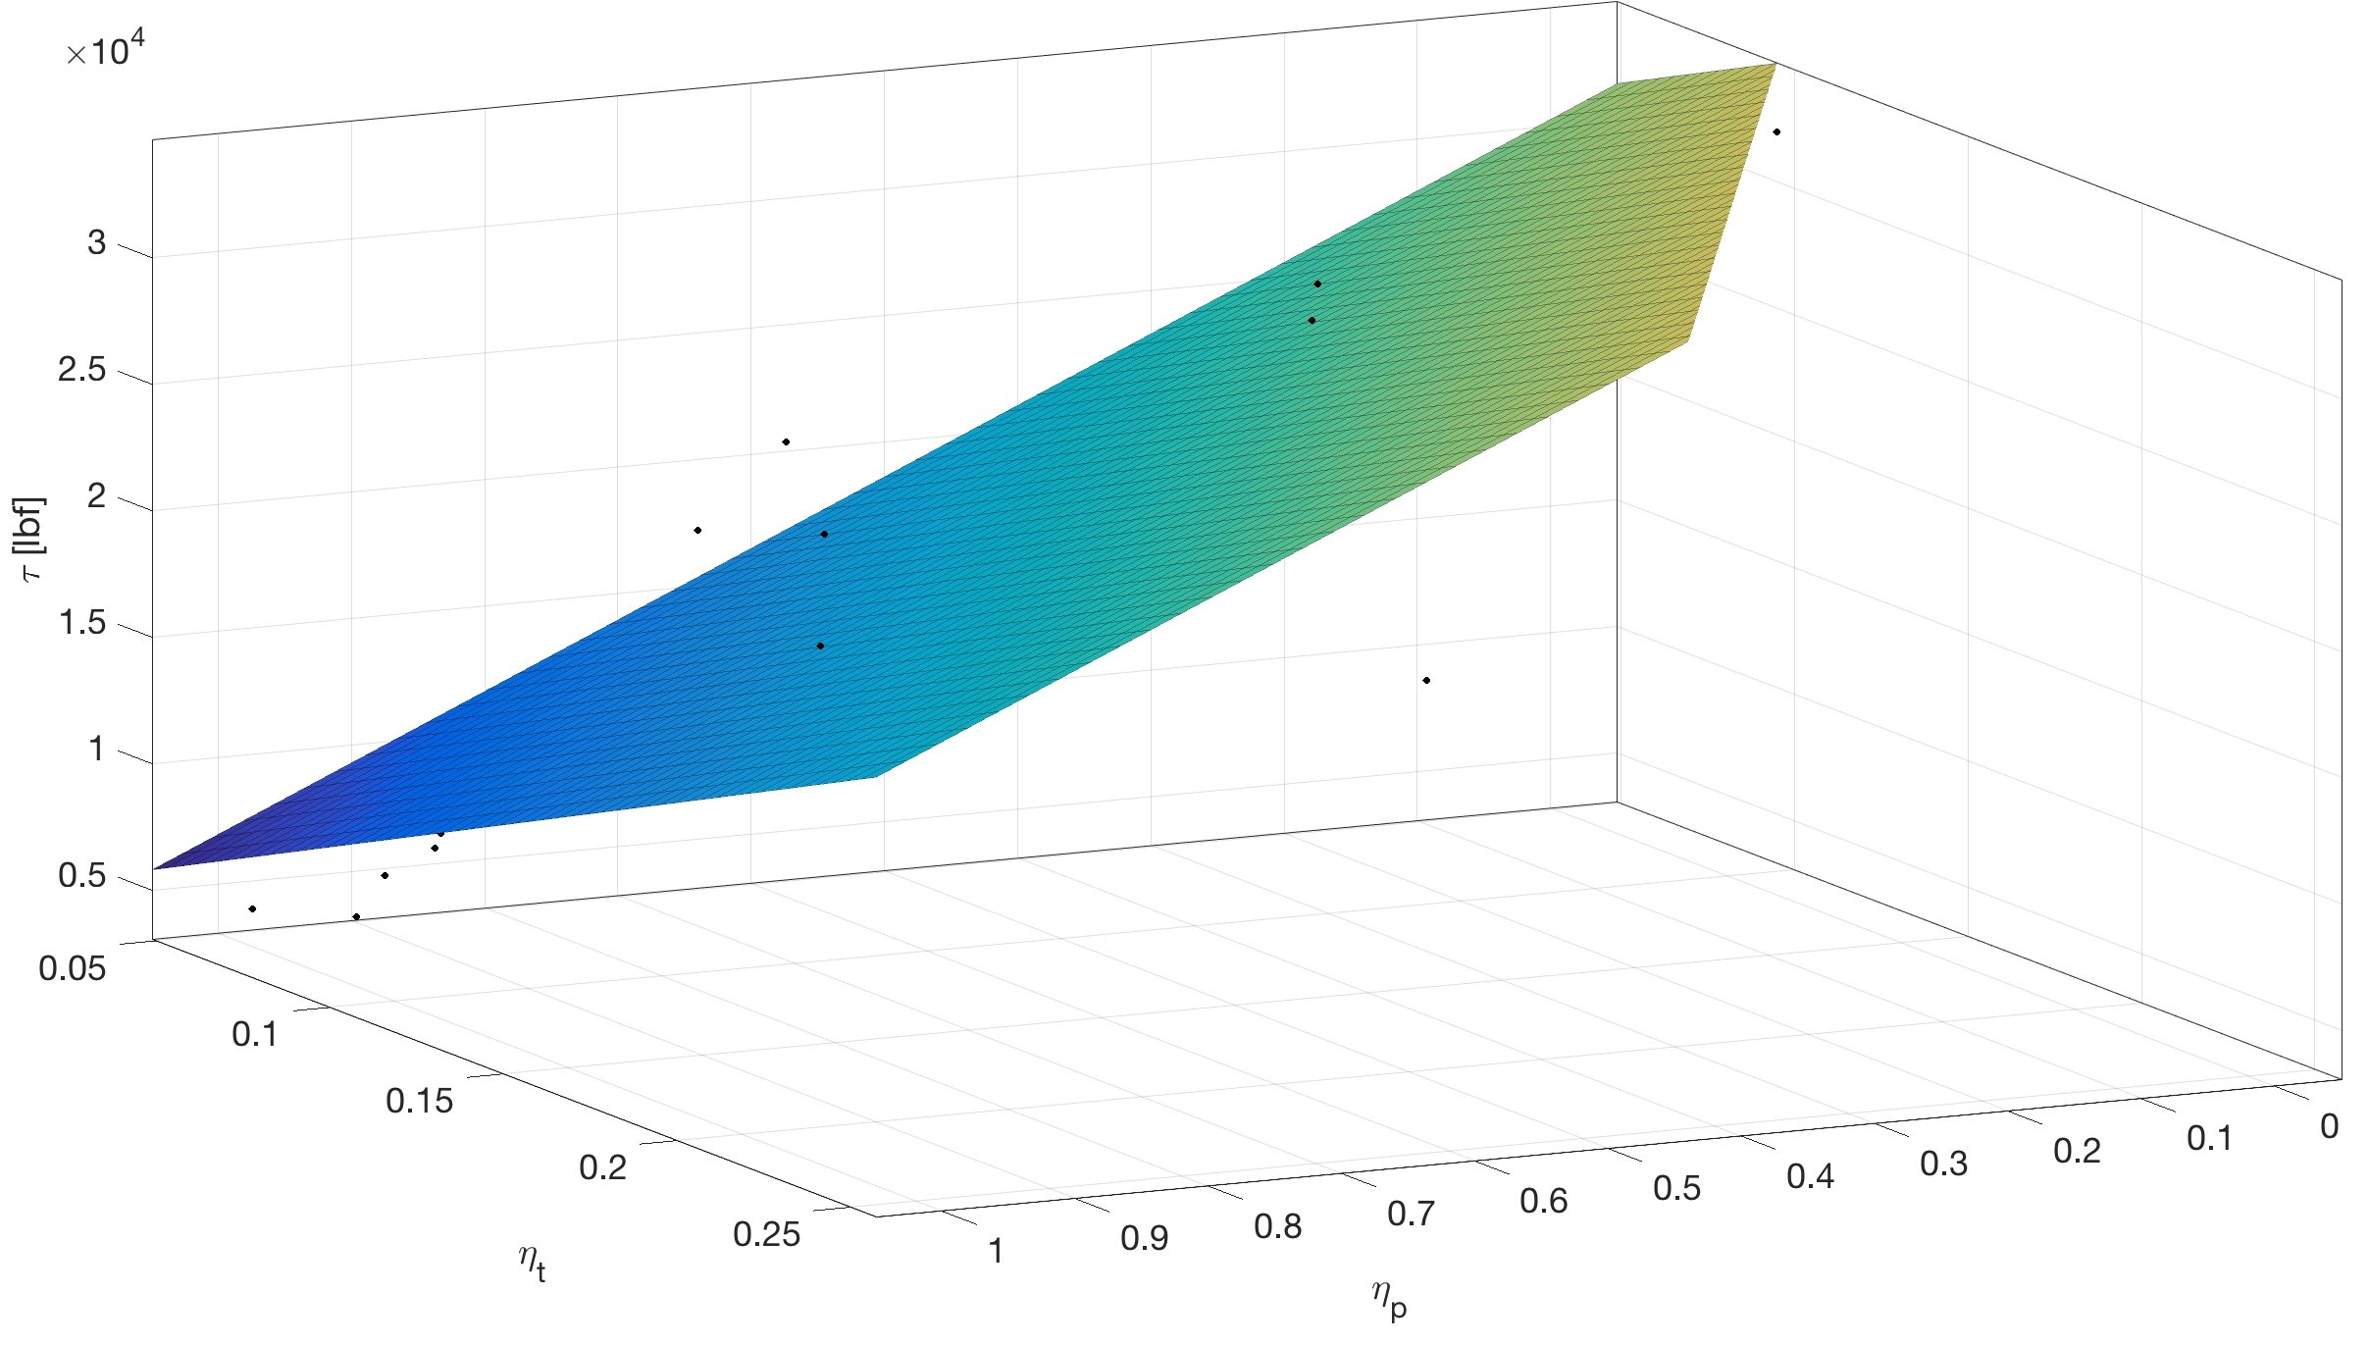
Thrust vs Efficiency

Slide 25
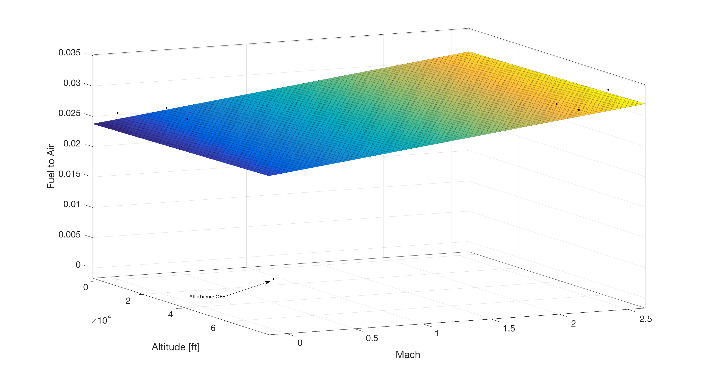
Fuel to Air

